Slide 1
Welcome to the Ally Skills Workshop TTT!
We're so happy you could join us today! A few things you can do while we are waiting to get started:
Get the files at https://frameshiftconsulting.com/ttt-materials/
Rename yourself: click on "Participants," mouse over your name, click on "Rename," and type in the name you want other people in the meeting to use for you. If you like, include your gender pronouns. Example: "Valerie (she/her/hers)".
You are welcome to turn off your video, use your favorite virtual background, or show us your pet!

Slide 2
Ally Skills Workshop
Train-the-trainers
Kendall Howse & Valerie Aurora
https://frameshiftconsulting.com
CC BY-SA Frame Shift Consulting, Dr. Sheila Addison

Slide 3
Schedule - day 1
Introduction
Brief review of Ally Skills Workshop slides
Optional example scenario facilitation
In-depth review of Ally Skills Workshop
How to teach the workshop - exercises
Q&A

Slide 4
Schedule - day 2
Reframing questions exercise
Students teach scenarios
Q&A session & freeform discussion

Slide 5
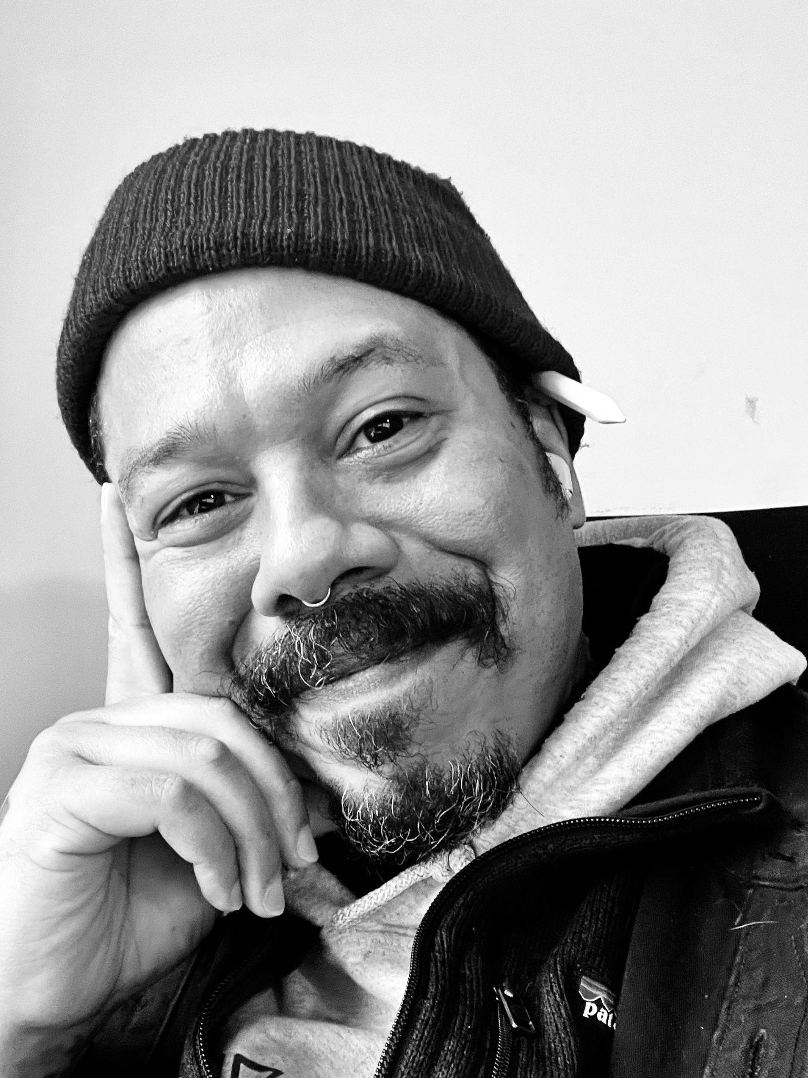
Kendall (Boo Boo) Howse
Award-winning designer, marketing strategist, and DEI leader
30+ years of activism and advocacy, focusing on practical antiracism strategies
Artist, writer, world-touring musician
Kendall Howse
k

Slide 6
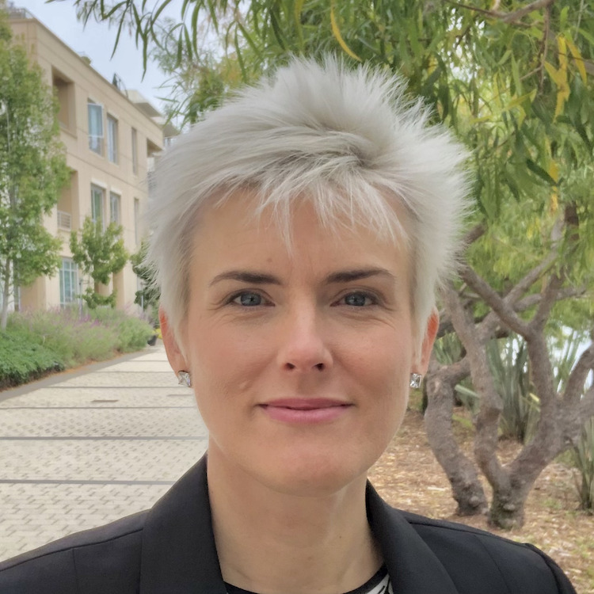
Valerie Aurora
Lead author of Ally Skills Workshop and Train-the-trainers
Taught ally skills to 4000+ people across the world
Taught 350+ people to lead the Ally Skills Workshop
Valerie Aurora
v

Slide 7
What is the Ally Skills Workshop?
Teaching people with privilege how to support more marginalized people in everyday ways
“Ally skills” vs. “allies”: focuses on actions rather than self-identification as a "good person"
Mainly small group discussion and group report-out
Audience: Volunteer-only, ideally 20-40% people from marginalized groups

Slide 8
Facilitating the Ally Skills Workshop is rewarding
“Can we get more training like that?” actual comment from student
Watch people have “Aha” moments
Take action to end social injustice
Highly interactive, time flies
No two workshops are ever the same

Slide 9
Facilitating the Ally Skills Workshop is hard
People ask tough questions
People tell you emotionally intense things during breaks
People say discriminatory things without realizing it
People get upset when they are confronted with their privilege or bias
You will have to kick someone out eventually

Slide 10
Facilitating the Ally Skills Workshop is hard
All organizations have conflicts between the interests of each individual employee, groups of employees, and the organization as a whole
HR is often at the intersection of such conflicts and teaching the workshop can highlight them
Staying away from legal advice or human resources rules is hard but often necessary

Slide 11
Workshops are better when...
Facilitator has significant experience being marginalized
Facilitator has a significant source of power or privilege
Facilitator is both compassionate and firm
Two people with different experiences co-facilitate

Slide 12
Ally Skills Workshop slides review

Slide 13
Ally Skills Workshop
Valerie Aurora & Kendall Howse
http://frameshiftconsulting.com/ally-skills-workshop/
CC BY-SA Frame Shift Consulting LLC, Kendall Howse, Dr. Sheila Addison, The Ada Initiative
k

Slide 14
Format of the workshop
20 minute introduction
2 hours group discussion of real-world scenarios
20 minute wrap-up and Q & A
Long breaks every hour, short "move" breaks in between
k

Slide 15
Kendall (Boo Boo) Howse
Award-winning designer, marketing strategist, and DEI leader
30+ years of activism and advocacy, focusing on practical antiracism strategies
Artist, writer, world-touring musician
Kendall Howse
k

Slide 16
Valerie Aurora
Founder Frame Shift Consulting
Taught ally skills to 4000+ people in Spain, Germany, Australia, Ireland, Sweden, Mexico, New Zealand, UK, and across the U.S.
Software developer in Linux and file systems for 10+ years
Valerie Aurora
v

Slide 17

What are ally skills? Some terminology first:
Privilege: an unearned advantage given by society to some people but not all
Oppression: widespread inequality that is present throughout society, that helps people with more privilege and harms those with fewer privileges
v
Notes:
https://commons.wikimedia.org/wiki/File:Rubin2.jpg

Slide 18
More terminology
Marginalized person: a member of a group that is the main target of a system of oppression
Ally: someone that society gives privilege to that is working to end oppression and understand their own privilege
Actions
v

Slide 19
Allyship is an action, not an identity
Being a marginalized person takes no action - oppression just happens to you, no matter what
Being an ally is about what you do, so let's talk about "ally skills" instead of "allies"
Depending on the situation, you may switch between being a marginalized person and being able to take action as an ally
v

Slide 20
Example
Privilege: The ability to walk into a convenience store and have the owner assume you are there to buy things and not steal them
Oppression: The self-reinforcing system of stories, TV, news coverage, police, and legal system stereotyping Black people as criminals, that benefits non-Black people and harms Black people
v
Notes:
Let’s do a quick example. Here’s an example of a privilege some of you may not even realize you have. (Read slide) Note how the ally is defined by their actions.

Slide 21
Example
Marginalized person: Any Black person who wants to enter a convenience store
Ally: A non-Black person who donates to legal system reform organizations, actively objects to racist stories, calls their representatives to support police reform, and reads news articles about this privilege
v
Notes:
Let’s do a quick example. Here’s an example of a privilege some of you may not even realize you have. (Read slide) Note how the ally is defined by their actions.

Slide 22
Why focus on ally skills?
In an experiment, researchers found that when marginalized people work to increase diversity, supervisors give them worse performance evaluations
But when more privileged people work to increase diversity, it does not harm their performance evaluations (and may improve them)
Does valuing diversity result in worse performance ratings for minority and female leaders? http://amj.aom.org/content/early/2016/03/03/amj.2014.0538.abstract
k
Notes:
Marginalized people are more likely to suffer retaliation when they speak out against oppression. This great study from 2016 looked at what happened to men vs. women and people of color vs white people when they did what they called "engage in diversity-valuing behavior." Listen to this quote: (Read slide)

Slide 23

Let's focus on ally skills
For this workshop, let's assume that oppression exists, it's bad, we should try to stop it, it's possible to stop, etc.
Disagree? No problem, just argue about it somewhere else
We can't give legal advice or tell you what your employer's rules are
CC BY-SA Todd Chandler
https://flic.kr/p/gqhYR2
k

Slide 24
Exercise: Identify your power and privilege
Privilege and power are often invisible to people who have them, but identifying them helps you act as an ally
This exercise is voluntary - you do not have to do it
If people assume you have a privilege that you do not, you can make your own decision about whether to include it
Download at https://frameshiftconsulting.com/materials/
k
Notes:
https://incompetech.filmmusic.io/song/3499-chill/

Slide 25
What did you think?
Do you have more or less power than you thought?
Do you have more or less privilege than you thought?
Any surprises or things you hadn't thought about before?
https://flic.kr/p/H2cL7F
CC BY-SA jason gessner
k

Slide 26
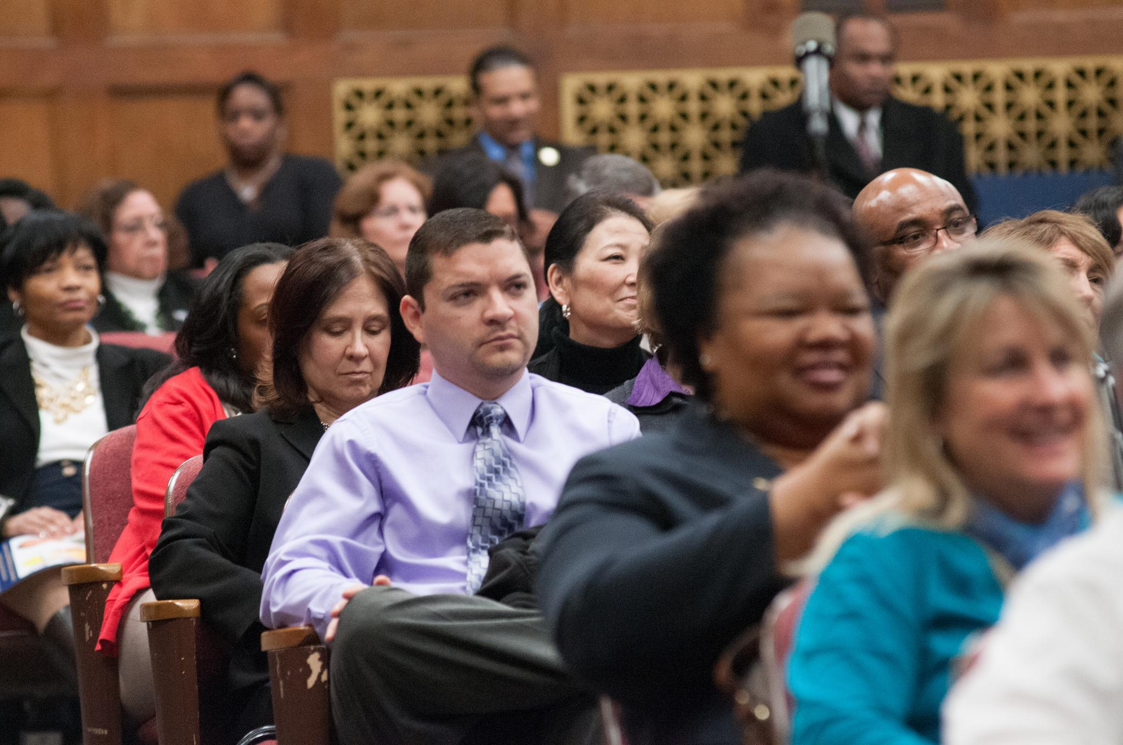
Basics of ally skills
Be short, simple, firm
Don't try to be funny
Play for the audience
Practice simple responses
Pick your battles
v
Notes:
Public domain https://flic.kr/p/e52K1T

Slide 27
While you're trying to help one group, don't be:
✖ sexist
✖ homophobic
✖ transphobic
✖ racist
✖ ableist
✖ ageist
✖ classist
✖ casteist
… and don't criticize people's bodies or attractiveness
v

Slide 28
What if I make a minor mistake?
Acknowledge, apologize,
and move on.
k

Slide 29
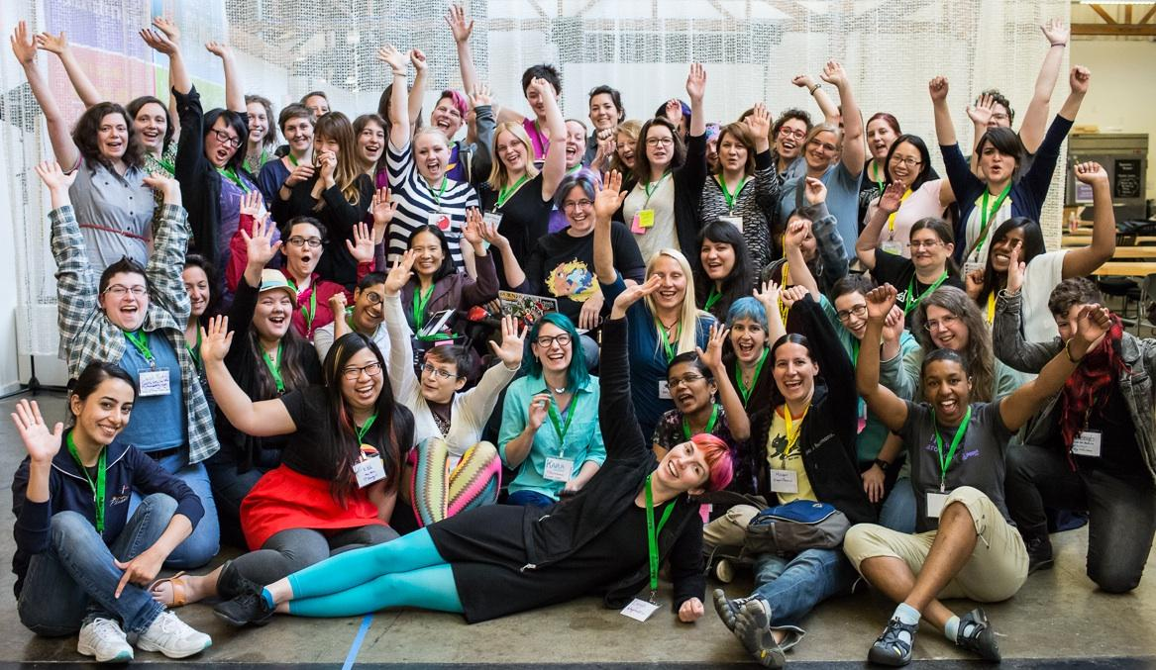
One of Valerie's mistakes: "You guys"
CC BY-SA Jenna St Martin photo
v

Slide 30
Help us create a safer space
You may leave or return at any time without explanation
This workshop is designed to be voluntary
You only have to share if you feel comfortable doing so
Please anonymize stories if you can
Joining groups is optional
Tell us if you should not be in a group with someone
v

Slide 31
Preparing for group discussion
Each group will choose a note-taker and moderator
Moderator interrupts people who are speaking too much and invite others to speak
Feel free to moderate the moderator! 🙂
Note-taker writes a short summary of what you talked about and reports out when you return
Do not volunteer to be note-taker more than once!
v

Slide 32
DREADED GROUP CHOOSING TIME
Form groups of 4 - 6 people
Groups that are more diverse have better discussions
Changing groups at breaks is encouraged
Try not to sit with people you usually talk to
Introduce yourself with one (1) sentence

Slide 33
A few more tips for group discussion
There aren't any misleading scenarios
"You" in the scenario means "a potential ally"
Focus on what an ally can do
If necessary, make up additional details
When you get the 1 minute warning, keep talking!
Note-taker: don't use the breakout group chat for notes
v

Slide 34
Scenarios & group discussion

Slide 35
Vote: Do the example scenario facilitation?

Slide 36
Scenario: What could an ally do?
At a meeting, a woman makes a suggestion, but no one picks up on it. Later on in the meeting, a man makes the same suggestion and is given credit for it.
Remember, choose your notetaker and moderator!

Slide 37
Tip: Effective and just meetings have structure
Meetings without explicit structure inherit structure from society, reinforcing systems of oppression
Use structure to fight oppression: agenda, meeting roles, reserved speaking time, hand signals, etc.
Useful meeting roles: facilitator, moderator, note-taker, timekeeper
https://frameshiftconsulting.com/meeting-skills/

Slide 38
Who is speaking in your group?
Who is speaking most in your group?
Is someone having difficulty being heard?
Are there patterns related to gender, race, age, or anything else?
How do these discussions compare to ones you have in other contexts?

Slide 39
2-4 more scenarios

Slide 40
Goal-setting exercise
Start planning how to use ally skills in your life!
Download the goal-setting exercise: https://frameshiftconsulting.com/#materials
Spend 5 minutes filling it out
Type "done" in chat when you are done

Slide 41
Advanced ally skills
Speak less, listen more - except when speaking is risky
Treat ally actions as bare minimum expectation
Follow and support leaders from marginalized groups
Follow your discomfort: if something makes you feel bad, find out more and understand why before reacting
When you make a mistake, acknowledge, apologize, and move on

Slide 42
Ally Skills Workshop
http://frameshiftconsulting.com/ally-skills-workshop
Frame Shift Consulting

Slide 43
End of Ally Skills Workshop slide review

Slide 44
Short break

Slide 45
Preparing to teach the workshop
Customize the workshop introduction
Recruit participants
Choose scenarios
Review resources on fighting oppression
Practice facilitation skills

Slide 46
Customize the workshop introduction
Create your introduction slides
Include some privilege you have
If more than one facilitator, decide which person will present which parts

Slide 47
Exercise: Identifying your power and privilege
Find the power and privilege exercise you filled out
Identify a privilege that makes teaching the workshop easier for you
Write a 1-2 sentence introduction for yourself that includes one privilege and explain how it gives you the opportunity to make the world better
Then introduce yourself with optional gender pronouns

Slide 48
Selecting workshop participants
Participants must be volunteers - NON-NEGOTIABLE
Screen participants in advance for public workshops
Avoid large power differences between participants (usual rule: only three levels of hierarchy in a workshop)
Ideal class size is 20 to 30 participants
Aim for 20-40% members of marginalized groups

Slide 49
Do not record
Do not record or broadcast the workshop! People won't feel safe asking questions or having discussions
Recording is possible if you edit out participants

Slide 50
Choosing scenarios
Scenarios are real-world examples of situations in which people can act as allies that the participants will discuss
3 - 5 scenarios per workshop
Start and end with easy scenarios
Slides on web sites include some scenarios
Ask participants for suggestions in advance

Slide 51
General facilitation skills
Practice politely but firmly standing your ground
Cultivate compassion to the entire group
Practice smiling, nodding, and praising
Practice apologizing, correcting yourself, and moving on
Practice admitting you don't know the answer
More resources in the Facilitator's Guide

Slide 52
Recommended reading/watching/listening
Facilitator's guide
Ally Skills Workshop handout
"How to Talk to Your Boss About Race" by Y-Vonne Hutchinson
"Better Allies" by Karen Catlin
"So You Want to Talk About Race" by Ijeoma Oluo
"Crip Camp" documentary

Slide 53
Feel free to change the workshop
This next section is about understanding why each part of the workshop is there
You can change, remove, or add parts to make it better for your organization if you have different conditions
Open up the workshop slides to follow along with the description of how and why each part exists
https://frameshiftconsulting.com/ttt-materials/

Slide 54
Introducing the workshop
Give credit according to the terms of the Creative Commons Attribution-ShareAlike license
While waiting for everyone to arrive, ask why people came to the workshop
Describe the high level format and schedule
Introduce yourself

Slide 55
Acknowledge a privilege and explain it
Start by calling out one of the ways that you have privilege and how you are using it to end inequality
Define privilege, oppression, etc.
Give a concrete example that is non-obvious to the majority of your audience
This makes it safe for the audience to own their privilege

Slide 56
Educate them on privilege and ally actions
Share some research on different response to ally action versus self-advocacy
Remind people that the goal is to act as an ally in ways that ultimately destroy whatever privilege they are using
Have the class do the privilege and power identification exercise

Slide 57
Limit the scope of the workshop
Each line on this slide is about preventing a bad thing that happened in a past workshop by limiting scope
Facilitator will not discuss legal advice or HR policies
No debates about if oppression exists, is bad, should be fought
Not giving advice to marginalized groups
Refer back to this slide to stop digressions

Slide 58
Review basic ally skills
People have tons of self-imposed rules for responding to oppression: must be witty, well-researched, etc.
Identifying and lowering these standards increases chances of taking action
Emphasize “do this while not harming other groups” - this happens a LOT otherwise

Slide 59
Talk about what to do if someone makes a mistake
Answer: acknowledge, apologize, and move on
Give other people room to make mistakes by sharing a minor mistake you made, and how you responded
Sharing a mistake models vulnerability, apologizing, and correcting yourself
Do not use an experience that is highly emotional or painful for either you or others

Slide 60
Sharing a story example: "You guys"
CC BY-SA Jenna St Martin photo

Slide 61
Exercise: Share a story about a mistake you made
Think of a time you did or said something oppressive that you can share with the class
Choose something mild that won't upset people a lot
Include what you did afterwards: apologized, made amends, developed a new habit, etc.
Tell the story to your group

Slide 62
Break

Slide 63
Review safer space parameters
Give people permission to leave/return, not join groups, not share difficult experiences
Ask people to send a private chat if they don't want to be in a group with someone, and normalize this

Slide 64
Setting up the workshop space
Projector with screen that can be viewed by all participants and three microphones
Ideally, round tables seating 4-6 people - no tables is okay, but then arrange chairs in circles
Groups should be close enough that everyone can hear one person speaking loudly, but far enough apart they can have conversations at the same time

Slide 65
Setting up the workshop space
Arrive 30 minutes early to do room setup - it will ALWAYS be wrong
Pass out handouts, pens, name tags
Place a chair for you to sit in during group discussions that is far enough away to not be obviously listening
Move/change anything that seems like it will interfere!

Slide 66
Forming groups
Forming diverse groups is awkward! What helps:
Pre-formed groups via seating arrangements
Reminding people that everyone is a volunteer
Encouraging people to switch groups at breaks
Telling people that discussions are better with lots of different perspectives
Framing this as an opportunity to hear different points of view people normally don't get to hear

Slide 67
Guiding scenario discussion
Each scenario takes about 15 - 20 minutes total
Read the scenario and ask if anyone has questions
Tell them to discuss for 5 - 8 minutes
Pay attention to rhythm of discussion, if someone is dominating discussion, etc. and intervene if necessary
Give 30 seconds warning before ending discussion

Slide 68
Give instructions for organizing groups
Tell them to choose a moderator and notetaker and explain what they do
Ask them to change notetakers every time
Remind them to do this in the first scenario slide before you send them to the breakout rooms

Slide 69
Give them final discussion tips
Assure them that there are no trick questions
Tell them to make up details if they feel they need them
Ask them to focus on how an ally could respond, not the person being marginalized
Explain that the "you" in the scenario is a theoretical person who could act as an ally, not literally "you"

Slide 70
Why all this preparation?
Without all this, we reproduce oppression inside the workshop - privileged people dominate discussion
With all this, oppression can still happen in group discussions, but it is less common
If I leave accidentally leave a slide out… mayhem and confusion
Best way to learn ally skills is to do them in the workshop!

Slide 71
Guiding scenario report-outs
Starting with a different group each time, ask the notetaker to report out major points of discussion
Ask them not to repeat things other groups already said and praise anyone who does this
Briefly affirm good suggestions and explain bad suggestions (really bad ones immediately)
Don't ask for additional comments!!!

Slide 72
What if someone talks too much in their group?
Tell the whole class "If you know you speak a lot, don't speak first and let silence go longer before speaking"
Take them aside during a break and say you noticed them speaking a lot
Pass them a note
Directly ask them to stop speaking in front of everyone

Slide 73
Guiding scenario report-outs
Ask everyone to stop talking (they won't, use bell)
Starting with a different group each time, ask them to report out major points of discussion
Ask them not to repeat things other groups already said
Briefly affirm good suggestions and explain bad suggestions (really bad ones immediately)

Slide 74
Guiding scenario report-outs
Wait till end of report-out to add any missed points - give participants a chance to discover them first
Write down points you want to cover and cross them off
Certain questions almost certainly will come up in certain scenarios
Example slides come with “tip” slides in between scenarios that have useful links/concepts/explanations

Slide 75
Practice politely but firmly standing your ground
Choose a moderator in your breakout room
Moderator chooses facilitator and questioner
Suggested argument "Introverts are a marginalized group"
Facilitator politely but firmly responds with facts, then shuts it down

Slide 76
Exercise: Polite but firm, suggested text
Arguments: Introverts are at a disadvantage, introverts should get accommodations, compare with other marginalizations
Responses: Little evidence for introvert/extrovert difference in treatment, environment, intersectionality, trivializing marginalization, ask for help from others
Moving on: Let's take it offline, want to get to other topics, let's talk after class

Slide 77
Summary of ideal facilitation style
Affirm and praise frequently - smile and nod
Be polite but firm about what you know to be true
Let participants come up with answers first whenever possible
Limit length of report-out
Summarize missed points at end of discussion (use written notes and mark points off as people say them)

Slide 78
Ending the workshop
Do goal-setting exercise
Explain more advanced ways to continue education in ally skills
Thank everyone for participating, tell them it was a great workshop because they participated, ask them to give themselves a round of applause
Stick around for questions and discussion

Slide 79
Send an anonymous survey
Send an anonymous survey after the workshop
Schedule time to read the results of the survey when you can handle negative comments (but mostly they will be positive)
You want some negative feedback
Will always get "too hard" and "too easy" (same workshop)

Slide 80
What if someone joins late?
Do NOT allow people to participate in group discussion if they missed the introduction - this is crucial
Feel confident in your ability to say no and tell people they have to leave
If you are feeling generous, you can go over the handout with them while the rest of the groups are discussing a scenario (or if you have two facilitators, one can do this)

Slide 81
What if you have to ask someone to leave?
Call a 5 minute break
Pull them aside where you can't be overheard
Say something apologetic and non-blaming about how the workshop isn't a good fit, etc.
Suggest that they can attend another workshop
Keep repeating yourself until they leave

Slide 82
Hard stuff rarely happens
Asking someone to leave happens ~1% of workshops
Someone obnoxious happens ~5% of workshops
You can designate someone to help you
It's okay to make a mistake - not the end of the world
If your career is at risk, protect your career first

Slide 83
Practice interrupting with role play
Interrupting is a crucial facilitating skill
Interrupting can be both good and bad; interrupting in ways that reinforce oppression is bad
Interrupting is vital when someone is saying something harmful
Interrupting is important when someone is taking up too much time

Slide 84
Interrupting exercise: Example
A participant said something sexist and another participant pointed it out
First student apologized and started to defend themself at length
I said "Thank you for demonstrating to the class how to apologize, correct yourself, and move on" until they stopped talking
Notes:
How to share sound in Zoom: https://support.zoom.us/hc/en-us/articles/201362643-Sharing-Computer-Sound-During-Screen-Sharing
https://www.newmediarights.org/business_models/artist/are_historical_speeches_public_domain

Slide 85
Useful interrupting phrases
"I'm so sorry, but I want to be sure everyone has time to speak. Could you summarize?"
"I think what you're trying to say is X, is that right?"
"I hate to interrupt, but I know people really want to get to the rest of the scenarios."
"I'm going to interrupt you and ask you to follow up after the workshop, is that okay?"

Slide 86
Exercise: Practice interrupting with role play
Choose a moderator to select who goes next
One person read out loud from the facilitator's guide (or talk about something extemporaneously)
Another person practices interrupting them
Switch roles and repeat until everyone has practice interrupting

Slide 87
Correcting mistakes made in good faith
Often someone will say something that reinforces oppression when they are intending to do the opposite
Patronizing: "You're so articulate!"
Implied exclusion: "This year, we all just found out [common knowledge for a marginalized person]."
Reinforcing stereotypes: "I assigned that to you because you're so good at [stereotyped task]."

Slide 88
Useful phrases for good faith correction
Acknowledge good faith, be compassionate, rephrase
"I understand that you were trying to be complimentary, but what I heard was [oppressive comment]."
"I used to say similar things about [group], but then someone kindly told me that it was hurtful in [X way]."
"I appreciate that you care about being inclusive. What do you think about [more inclusive version]?"

Slide 89
Example: Correcting mistakes in good faith
A white woman talking to me (also white) about conflict while discussing anti-Black racism in her company says, "We want to feel safe talking about racism with them."
My correction: "I wouldn't put it that way. I would say, we want everyone to feel safe talking about racism."
Her: [long pause] "Thank you for pointing out my mistake so kindly. I learned a lesson and only feel slightly ashamed instead of very ashamed."

Slide 90
Exercise: Correcting good faith mistakes
Choose a moderator to organize who goes next
Take turns role-playing, one person saying the mistake and a second person correcting the mistake
Use example mistakes and corrections in chat
Repeat until everyone has a chance to play both roles

Slide 91
Start choosing scenarios to facilitate tomorrow
This is a great opportunity to practice facilitating when the stakes are lowest
Participation is optional
You may co-facilitate with a classmate or with a facilitator
See "Example scenarios" in the Facilitator's Guide

Slide 92
Q&A
Start thinking about what scenario you want to facilitate! When you decide, email contact@frameshiftconsulting.com

Slide 93
Q&A

Slide 94
End of day 1

Slide 95
Schedule
Day 2
60 min: Reframing questions exercise
60 min: Students teach scenarios
30 min: Break (shorter breaks every ~30 min)
60 min: Students teach scenarios
30 min: Q&A session & freeform discussion

Slide 96
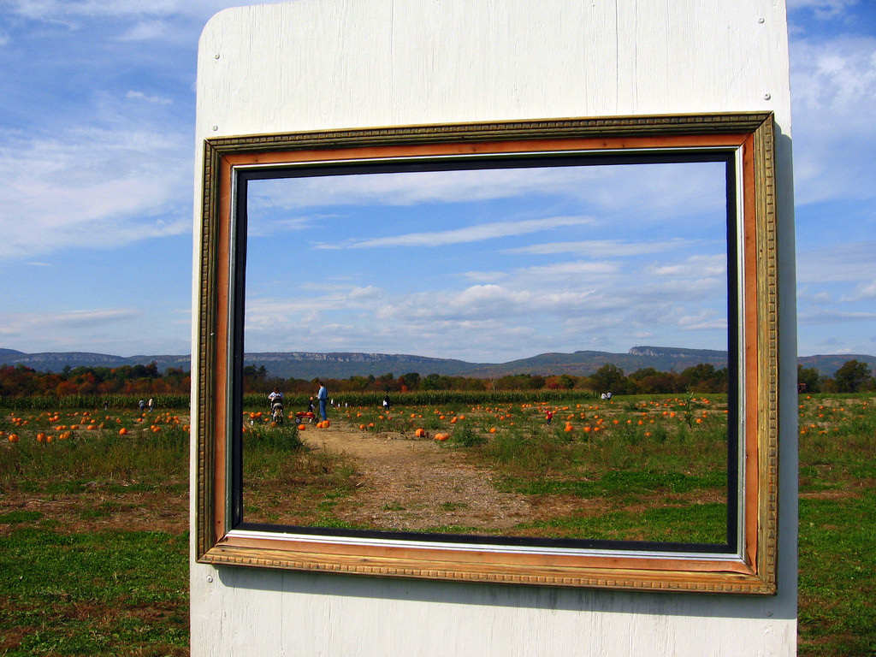
Reframing questions
CC BY Amy https://flic.kr/p/8Ldbrd

Slide 97
Reframing questions
CC BY Amy https://flic.kr/p/8Ldbrd

Slide 98
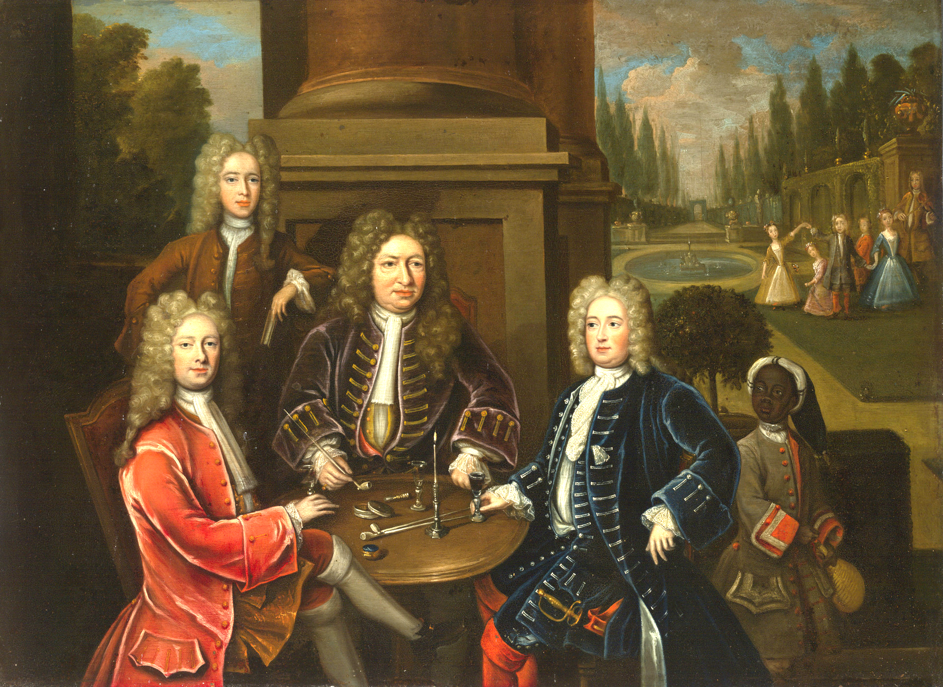
Notes:
https://artgallery.yale.edu/collections/objects/52745

Slide 99
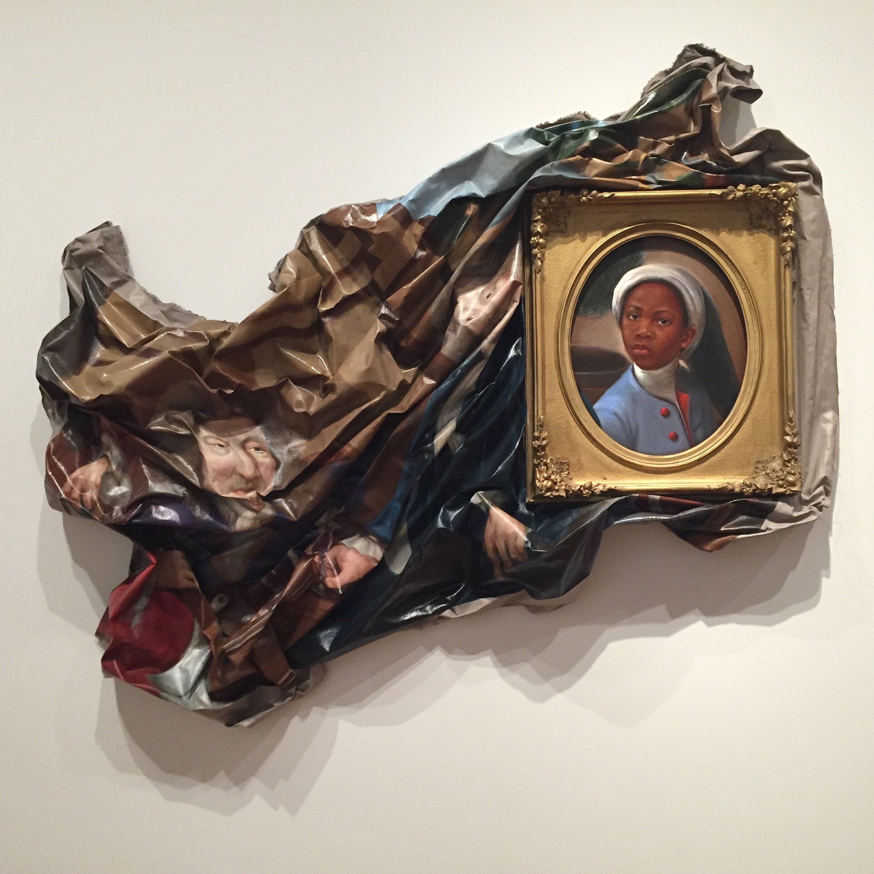
"Enough About You" Titus Kaphar (2016)
Notes:
Titus Kaphar, Enough about you
https://www.wbur.org/npr/562836477/titus-kaphar-how-can-we-address-centuries-of-racism-in-art
https://www.culturetype.com/2018/10/17/titus-kaphar-whose-paintings-reconstruct-accepted-historic-narratives-is-a-2018-macarthur-genius-fellow/
https://twitter.com/jasonintrator/status/1084113594088865792 - source of photo
https://twitter.com/jasonintrator/status/1235012195009933312 - permission to use but also it is probably public domain

Slide 100
Why is reframing questions a useful skill?
People will have genuine questions about some apparent contradiction which means they have to be oppressive
Usually based on one or more of:
Incorrect facts
Ignoring systemic oppression
Putting burden of change on marginalized/less powerful

Slide 101
Reframing example
“You say you want us to treat women like everyone else, but then you want us to act differently around women. That's illogical!”

Slide 102
Assumptions
"Everyone" is "men"
All men like this abusive culture
What these men like defines "normal" behavior
Men should not have to change to accommodate women
Systemic sexism does not exist

Slide 103
Reframe assumptions
"Everyone" includes people of all genders
Many people dislike this abusive culture
Women should be included in defining "normal" behavior
Men should change to accommodate women
Systemic sexism exists

Slide 104
Reframing reply
"I used to think that too, because I thought that the way we were treating people was normal. But then I realized that our culture was only friendly to men who didn't mind being part of abusive culture. When I changed my definition of normal behavior to be welcoming and inclusive of women too, then I realized that we could treat everyone with equal respect and also be more welcoming of women."

Slide 105
Reframing process
What assumptions are they making?
Are those assumptions true?
What systemic oppression is being left out?
Where is the burden of change placed?
Rewrite the question with facts, inclusion of systemic oppression, burden of change on the privileged
Kindly walk them through the thought process

Slide 106
Useful reframing phrases
"So let's talk about an underlying assumption a lot of us have about that..."
"I hear you saying XYZ, what are some of the assumptions underlying that language?"
"I also used to wonder that same thing, and then I learned..."
"I used to think that, and then…"

Slide 107
Dealing with bad faith participants
Some people know they are making logical errors or basing arguments on lies and don't care
Debating people acting in bad faith just gives more weight and credit to their arguments than they deserve
You can still use reframing techniques, but you should play to the audience, not to the person acting in bad faith

Slide 108
How to practice reframing
Search for hot button topics on Twitter and read arguments from obvious throwaway accounts
Search for debunking of myths about marginalized groups
Practice asking the three questions about assumptions, context, and burden of change

Slide 109
Reframing exercises

Slide 110
Reframing exercise
“Affirmative action gives people of color in the U.S. unfair advantages over white people. How is that not discriminating on the basis of race?”
Assumptions?
Systemic oppression?
Burden of change?

Slide 111
Reframing reply
"We agree, giving people unfair advantages on the basis of race is not good. Unfortunately, white people have been the recipients of unfair advantages for centuries and continue to be so today. In order to make society more fair, affirmative action removes a small amount of that unfair advantage."

Slide 112
Reframing exercise
“Making jokes about sex isn't sexist. Women like to have sex too.”
Assumptions?
Systemic oppression?
Burden of change?

Slide 113
Reframing reply
"Whether or not women like to have sex has nothing to do with whether sex jokes are sexist. Because our society praises men for having sex and dehumanizes women when we talk about sex, sex jokes signal that it is okay to objectify and harm women. I want to make the world less sexist, not more sexist, so I don't make sex jokes."

Slide 114
Reframing exercise
“You are infringing on free speech, and how can we have an open and free society without that?”
Assumptions?
Systemic oppression?
Burden of change?

Slide 115
Reframing reply
"I agree, an open and free society is really important. What I notice is that some people get lots of speech, and others get silenced. When we defend speech that dehumanizes a whole group of people, we end up with less free speech, and an intolerant and closed society. Many countries have limits on free speech for things as mundane as protecting Disney's right to make money off Mickey Mouse. Let's protect people's lives, too."

Slide 116
You don't have to reframe a lot
Questions like this are relatively rare
Often the audience can help answer them
Your co-facilitator may have an idea
You can ask to come back to that after the break
You can say "I don't know, but I suspect there is a problem with assumptions/facts/burden of change"

Slide 117
Short break

Slide 118
Scenario facilitation practice

Slide 119
Practice leading scenario discussion
Your participation is voluntary
Choose an existing scenario or create a new one
Your choice on feedback: none/any, positive/negative, public/private, instructor/class
Your choice on whether participants can deliberately make it harder to facilitate

Slide 120
Scenario: What could an ally do?
In meetings, you notice that both clients and your coworkers tend to speak more to older and/or more tenured coworkers, even when responding to a question or comment from a younger and/or newer coworker.
k

Slide 121
Tip: Redirect the conversation
"I'm not sure. [NAME], what do you think?"
"You know who the expert on that is, [NAME]! [NAME], can you answer that?"
"[NAME] could probably give you a better answer than I can. [NAME], is this something you know?"
"I'd like to hear from [NAME] because they always bring a new perspective. [NAME], any thoughts?"
k

Slide 122
Who gets to be heard?
Who is speaking most in your group?
Is someone having difficulty being heard?
Are there patterns related to gender, race, age, or anything else?
How do these discussions compare to ones you have in other contexts?
k

Slide 123
Scenario: What could an ally do?
You are a manager. People keep complaining to you about the tone of one of your direct reports, who is part of a marginalized racial/ethnic group. You have been present for every situation they are complaining about, and you think your direct report has been behaving the same way as the people who are part of the dominant race/ethnic group.
v

Slide 124
Tip: tone policing/the “tone argument”
When members of marginalized groups advocate for themselves or their ideas, it violates expectations that marginalized people should be submissive and quiet
The same behavior in a person with a lot of privilege may be described as "passionate" or "committed"
Tone policing often uses the word "tone"
https://en.wikipedia.org/wiki/Tone_policing
v

Slide 125
Scenario: What could an ally do?
You are in a meeting about hiring more people from a marginalized group into positions of power. A colleague of yours says, "It's great to hire more people from this group, but let's not lower the bar." Before you can reply, another colleague says, "Oh yes, we'll be careful not to lower the bar."
k

Slide 126
Tip: Reframe the discussion
Assumption: at present, everyone has an equal chance of being hired
Reality: More marginalized people face a much a higher bar than people with more privilege, who often get a pass or exceptions to the process
Reframe: "Actually, the problem is that people in this group have to pass a higher bar, and we need to fix that."
k

Slide 127
Scenario: What could an ally do?
A co-worker comes out as trans. Another co-worker assumes you are cis and starts complaining to you privately about how ridiculous it is to expect everyone to start using your co-worker’s new name and pronouns.
k

Slide 128
Tip: Read Captain Awkward
Advice blog that answers questions on social interaction from an awkward, geeky perspective
Great for "How do I get someone to stop doing something without upsetting anyone?" type of questions (hint: someone is already upset)
http://captainawkward.com
k

Slide 129
Scenario: What could an ally do?
While talking about an incident of structural racism in the news, a colleague of yours who is part of the dominant racial group says proudly, "My parents raised me not to see color."
v

Slide 130
Tip: Recenter the conversation
"I decided to talk less about how un-racist I am and talk more about how to stop the racism that is happening."
"I heard that 'I don't see color' sounds like 'I don't see people being racist to you' and so I stopped saying it."
"It feels good to feel like I'm not the problem, but now I want to be part of the solution. And that means seeing race so that I notice when unfairness is happening."
v

Slide 131
Scenario: What could an ally do?
A woman you don't know is standing near your group at a conference or similar event in a male-dominated field. She is alone and looks like she would rather be talking to people.

Slide 132
Tip: Pay attention to patterns of discussion
Who is speaking most in your group?
Is someone having difficulty being heard?
Are there patterns related to gender, race, age, or anything else?
How do these discussions compare to ones you have in other contexts?

Slide 133
Scenario: What could an ally do?
At a meeting, a person who is hard of hearing makes a suggestion, but no one picks up on it. Later on in the meeting, a hearing person makes the same suggestion and is given credit for it.

Slide 134
Tip: Effective and just meetings
Good meetings have the following roles:
Facilitator
Timekeeper
Notetaker
Gatekeeper
https://frameshiftconsulting.com/speaking/#meeting

Slide 135
Scenario: What could an ally do?
You are eating lunch in the employee kitchen when a group sits down near you. One person comments loudly “If I ate that, I’d be as big as a house!” A higher-weight coworker is sitting nearby and can clearly overhear.

Slide 136
Tip: Weight discrimination at work
“Fat talk/diet talk” is seen as bonding but creates a hostile environment for other employees
Higher weight people face workplace discrimination, particularly women, regardless of ability to do the job
Body size is falsely equated with virtue: self-control, hard worker, in good health
Workplace “health initiatives” often discriminate
Notes:
Higher weight people are less likely to be hired, less likely to be given responsibility at work, more likely to receive negative performance evaluations, and less likely to be promoted, in addition to experiencing a “pay gap” with lower-weight colleagues
Talk about criticizing employees as “lazy” for taking the elevator

Slide 137
Scenario: What could an ally do?
On a company mailing list, someone writes “How would you explain this [technical thing] to your grandmother?”

Slide 138
Tip: Charles' Rules of Argument
Don't go looking for an argument
State your position once, speaking to the audience
Wait for absurd replies
Reply one more time to correct any misunderstandings of your first statement
Do not reply again
Spend time doing something fun instead
http://geekfeminism.wikia.com/wiki/Charles%27_Rules_of_Argument

Slide 139
Scenario: What could an ally do?
A Black person in your community points out that a conference in your community has all white speakers. They do this on a social media platform that you actively use to participate in this community. Several other people criticize the Black person for being too abrasive, aggressive, loud, out of line, etc.

Slide 140
Tone policing/The "tone argument"
When people speak up in support of oppressed groups, it makes people in the dominant group feel guilty and sad
A common response is to ask the people speaking up to not hurt the feelings of the dominant group
Often this uses the word "angry" and especially "tone"
http://geekfeminism.wikia.com/wiki/Tone_argument

Slide 141
Scenario: What could an ally do?
You are part of the performance review process at your company. The feedback for several women include comments like "Needs to work on her communication style," or "too aggressive." Fewer men's reviews have the same problems.

Slide 142
Hint: it’s not the women
"When we analyzed a sample of performance evaluations of men and women across three high-tech companies and a professional services firm, we found that women consistently received less feedback tied to business outcomes. [...] 76% of references to being "too aggressive" happened in women’s reviews, versus 24% in men’s."
Shelley Correll and Caroline Simard, https://hbr.org/2016/04/research-vague-feedback-is-holding-women-back

Slide 143
Tip: Bias interrupters
3 step process from UC Hastings WorkLife Law Center
Use metrics
Implement bias interrupters
Repeat as needed
Detailed list of bias interrupters for workplace systems:
http://biasinterrupters.org/

Slide 144
Scenario: What could an ally do?
A woman in your company goes on maternity leave. You are discussing which projects to assign to people after she has returned, including one that is in her area of expertise and requires some travel. A co-worker says, "She has a small baby, I assume she won't want to travel."

Slide 145

What Works for Women at Work
By Joan C. Williams and Rachel Dempsey
Four patterns of subtle bias, varying by race, ethnicity, appearance, etc.
Prove-it-again
The Tightrope
The Maternal Wall
Tug-of-war

Slide 146
Scenario: What could an ally do?
A co-worker comes out as trans. Another co-worker assumes you are cis and starts complaining to you privately about how ridiculous it is to expect everyone to start using your co-worker’s new name and pronouns.

Slide 147
Tip: Read Captain Awkward
Advice blog that answers questions on social interaction with specific suggested scripts and detailed explanations
Great for "How do I get someone to stop doing something without upsetting anyone?" type of questions (hint: someone is already upset)
http://captainawkward.com

Slide 148
Scenario: What could an ally do?
At a party at work, a male co-worker makes a joke about how much sex another male co-worker must have had in order to have so many children. Everyone is holding an alcoholic drink.

Slide 149
Why talking about sex at work is harmful
Double standard for straight sex and gay sex
"Family size" talk can be racism & religious discrimination
Some racist stereotypes are about sex or genitals
Fertility, pregnancy, adoption can be highly emotional

Slide 150
Why talking about sex at work is harmful, cont'd
Strong pressure to "be cool" about sex
Assumes parents are cis and straight
Double standard for sex for men and women
Sex talk => objectification & harassment of women
Take-away: Save talking about sex for outside of work

Slide 151
Myths about alcohol and bad behavior
The immediate physiological effects of alcohol are:
Loss of coordination
Sleepiness
Difficulty multitasking
Everything else (violence, sexual advances, rude comments) is voluntary and under conscious control:
http://www.sirc.org/publik/drinking4.html

Slide 152
How to counter cultural messages about alcohol
Don't serve alcohol at all (surprisingly popular!)
Serve high quality non-alcoholic beverages
Serve at same stations with same prominence
More tips on serving alcohol in an inclusive manner, by Kara Sowles:
https://modelviewculture.com/pieces/alcohol-and-inclusivity-planning-tech-events-with-non-alcoholic-options

Slide 153
Scenario: What could an ally do?
On an internal company chat channel with about 50 people, a co-worker is talking about a badly implemented software feature. They write, "That's so ghetto," followed by a smiling face emoji.

Slide 154
Tip: Have a concise code of conduct with examples
Have a short, clear, concise code of conduct that focuses on what not to do
Specifically list common forms of oppression
Put everything else (values, etc.) in separate documents
Hand over any dispute over CoC violations to an expert
https://frameshiftconsulting.com/code-of-conduct-book/

Slide 155
Scenario: What could an ally do?
Your team announces that the next team-building offsite activity will be playing laser tag.

Slide 156
Tip: Inclusive offsites
Design your offsite meetings to be inclusive
Make a list of marginalized groups and spend time researching how each might feel left out
List of more inclusive and less inclusive offsites here:
https://geekfeminism.wikia.com/wiki/Inclusive_offsites

Slide 157
Scenario: What could an ally do?
In your team's weekly meeting, you notice that the decision ends up being whatever the loudest, most persistent talker wants to do, even when you think it is not the best solution. You also notice that more marginalized people are interrupted more often and speak for less time.

Slide 158
Tip: Create psychological safety
Psychological safety means an environment in which people take turns sharing information
Google study showed the most productive and profitable teams have psychological safety
Two elements: sensitivity to others' feelings, and conversational turn-taking (equal speaking time)
https://en.wikipedia.org/wiki/Psychological_safety

Slide 159
Scenario: What could an ally do?
You are part of a hiring committee. A woman interviewer reports that an applicant refused to make eye contact with her and seemed dismissive of her questions. A man who interviewed the same applicant reports that they were enthusiastic and warm, and advocates strongly for advancing the applicant to the next level.

Slide 160
Tip: Listen to and amplify marginalized voices
Marginalized people are the early warning system for harmful employees: they often see the signs first
If you aren't a member of the marginalized group, you may have difficulty believing experiences like these
When a marginalized person shares these experiences, view it as a valuable, limited time learning opportunity
Amplify and back up these kinds of reports

Slide 161
Optional Q&A
Frame Shift Consulting
http://frameshiftconsulting.com

Slide 162
Alternate slides

Slide 163
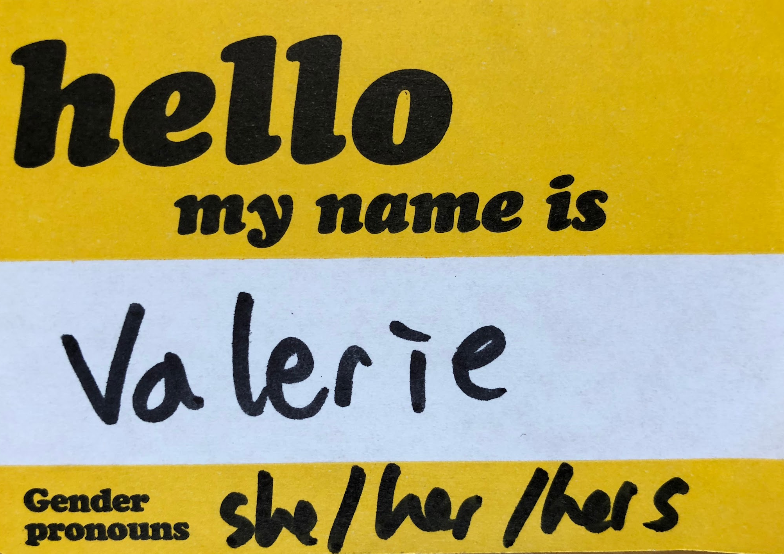
Welcome to the Ally Skills Workshop TTT
Please fill out a name tag & include the pronouns you normally use if you don't mind. Examples:
she/her/hers
he/him/his
they/them/theirs
Pronouns

Slide 164
Forming groups
Form groups of 4 - 6 people using Zoom breakout feature
If possible, have a mix of gender pronouns in each group
Participation in groups is voluntary - just don't join
Make new groups every scenario so people can get away from bad experiences

Slide 165
Video-specific teaching techniques
Meeting prep
Sound
Video
Body language
Preventing harassment

Slide 166
Meeting prep
Send out written tips for using the video system in advance
Give people 15 minutes before the meeting starts to troubleshoot and experiment with features
Start meeting with a slide with links to slides and other resources and instructions on changing names

Slide 167
Sound
ALWAYS use headphones/headset/earbuds
Ask students to use them to prevent feedback (buy cheap ones and send them)
Wired recommended - harder to forget and take with you!
Sound breaking up? Turn off video
Some groups keep video off by default for this reason

Slide 168
Video
Use three-point lighting
Place camera at eye level, near the video for students
Built-in laptop camera works fine
Background can be complicated as long as not distracting
Virtual backgrounds are great!

Slide 169
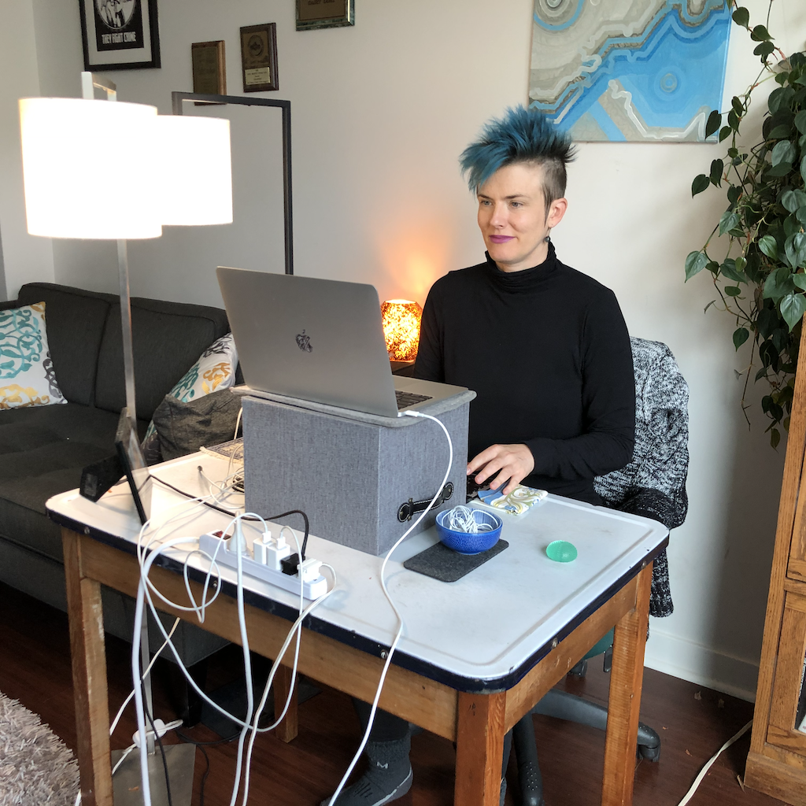
My setup

Slide 170
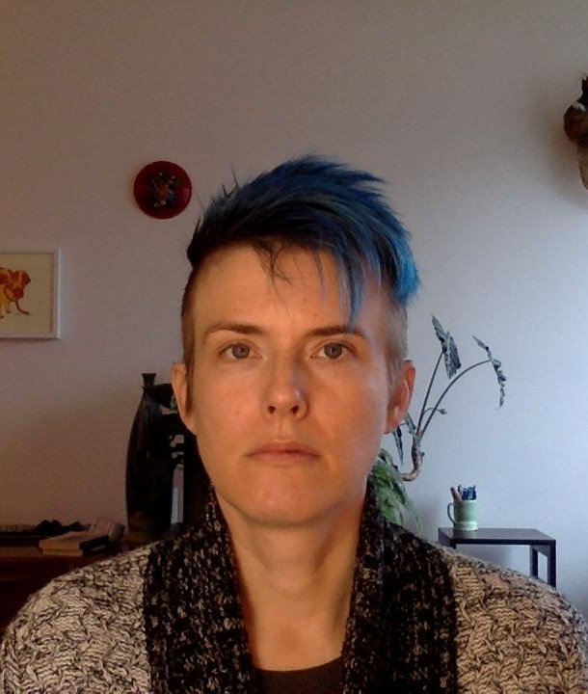
Body language for video
Beware of computer face!
Your image on students' screens is tiny compared to real life
Compensate the same way theater actors or ballet dancers do
Over-emote, exaggerate your expressions, use big gestures
Val's computer face

Slide 171
Exercise: Practice emoting more (optional)
Choose a timekeeper/moderator
Each person talks for 60 seconds, trying to emote more
If they aren't emoting "enough," make a "more" motion with your hands
If they are emoting "enough," give them a thumbs up
When 60 seconds is up, give them a round of applause

Slide 172
Review safer space parameters
Give people permission to leave/return, not join groups, not share difficult experiences
Ask people to send a private chat if they don't want to be in a group with someone, and normalize this

Slide 173
Give instructions for organizing groups
Tell them to choose a moderator and notetaker and explain what they do
Ask them to change notetakers every time
Remind them to do this in the first scenario slide before you send them to the breakout rooms

Slide 174
Give them final discussion tips
Assure them that there are no trick questions
Tell them to make up details if they feel they need them
Ask them to focus on how an ally could respond, not the person being marginalized
Explain that the "you" in the scenario is a theoretical person who could act as an ally, not literally "you"

Slide 175
Forming groups
Form groups of 4 - 6 people using Zoom breakout feature
If possible, have a mix of gender pronouns in each group
Participation in groups is voluntary - just don't join
Make new groups every scenario so people can get away from bad experiences

Slide 176
Guiding scenario discussion
Read the scenario, ask who could act as an ally,and ask if anyone has questions
Copy scenario into text chat and tell them to take notes in a form that can be pasted into chat
Tell them discussion time and start breakout rooms
Allow for 60 second delay/warning before rooms close

Slide 177
Guiding scenario report-outs
Starting with a different group each time, ask the notetaker to report out major points of discussion
Ask them not to repeat things other groups already said and praise anyone who does this
Briefly affirm good suggestions and explain bad suggestions (really bad ones immediately)
Don't ask for additional comments!!!

Slide 178
Guiding scenario discussion
Read the scenario, ask who could act as an ally, and ask if anyone has questions
Copy scenario into text chat
Tell them to discuss for 5 - 8 minutes and start breakout rooms
Close breakout rooms 60 seconds before time is up to allow for 60 second delay/warning

