Slide 1
Meeting Skills
Valerie Aurora
(she/her/hers)
http://frameshiftconsulting.com/
© Frame Shift Consulting, 2015 - 2022
CC BY-NC-ND 4.0

Slide 2
Outline
Introduction
Summary of good meeting habits
Summary of habit-building techniques
How to build good meeting habits, with exercises
Fighting Zoom fatigue with good meeting habits
Case studies and Q&A

Slide 3
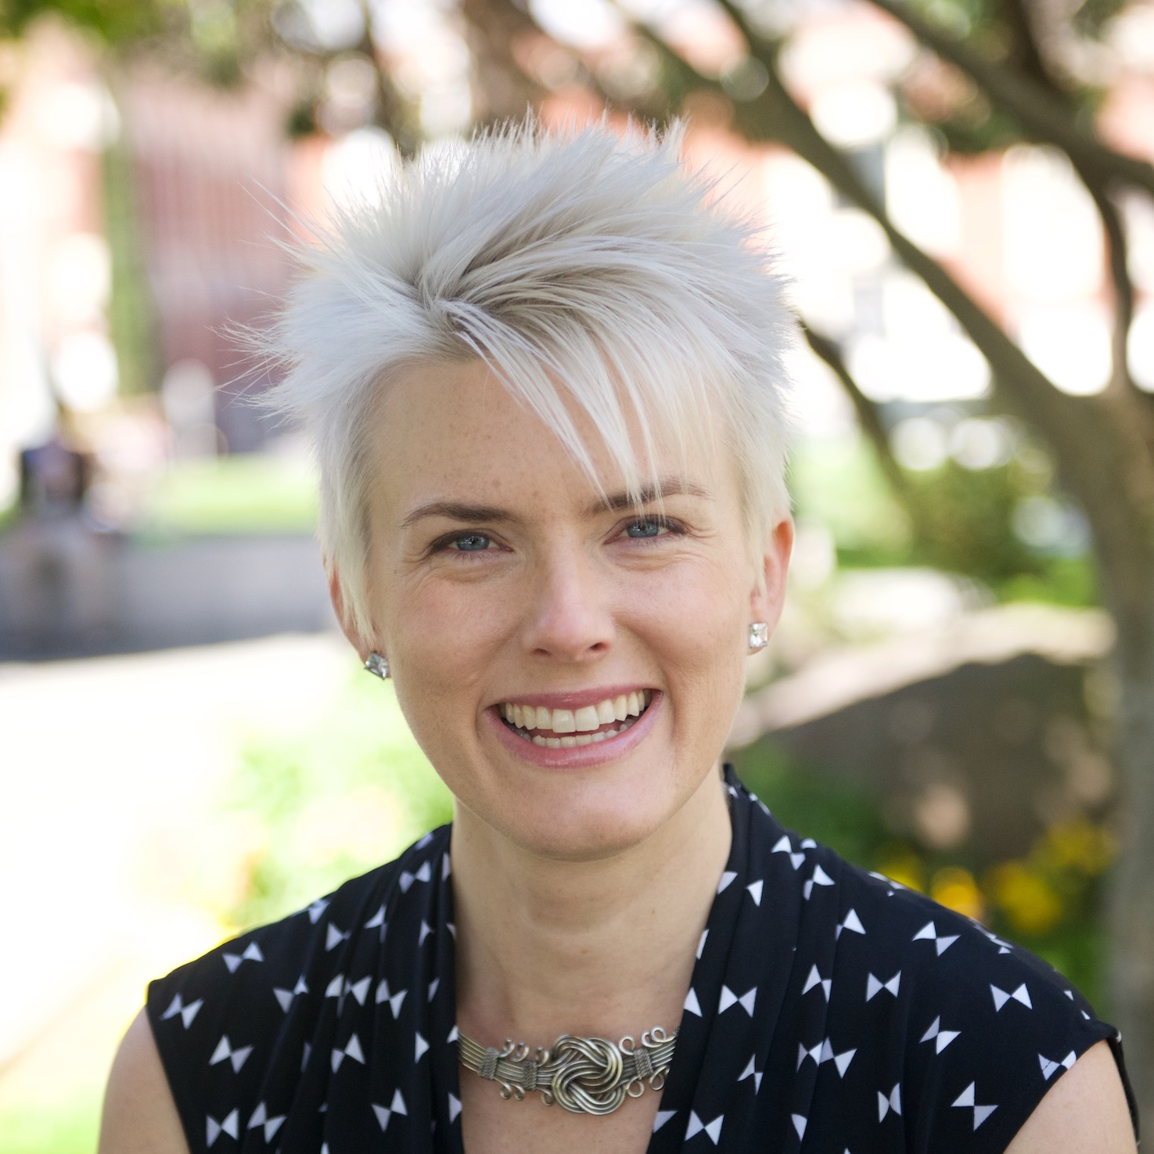
What do I know about running meetings?
Facilitated over 75 discussion oriented workshops w/ 30 people
Served on two non-profit boards of directors
Ran unconferences - dozens of tiny self-organized meetings
Formerly IBM, Intel, Red Hat, etc.
Valerie Aurora
(she/her/hers)

Slide 4
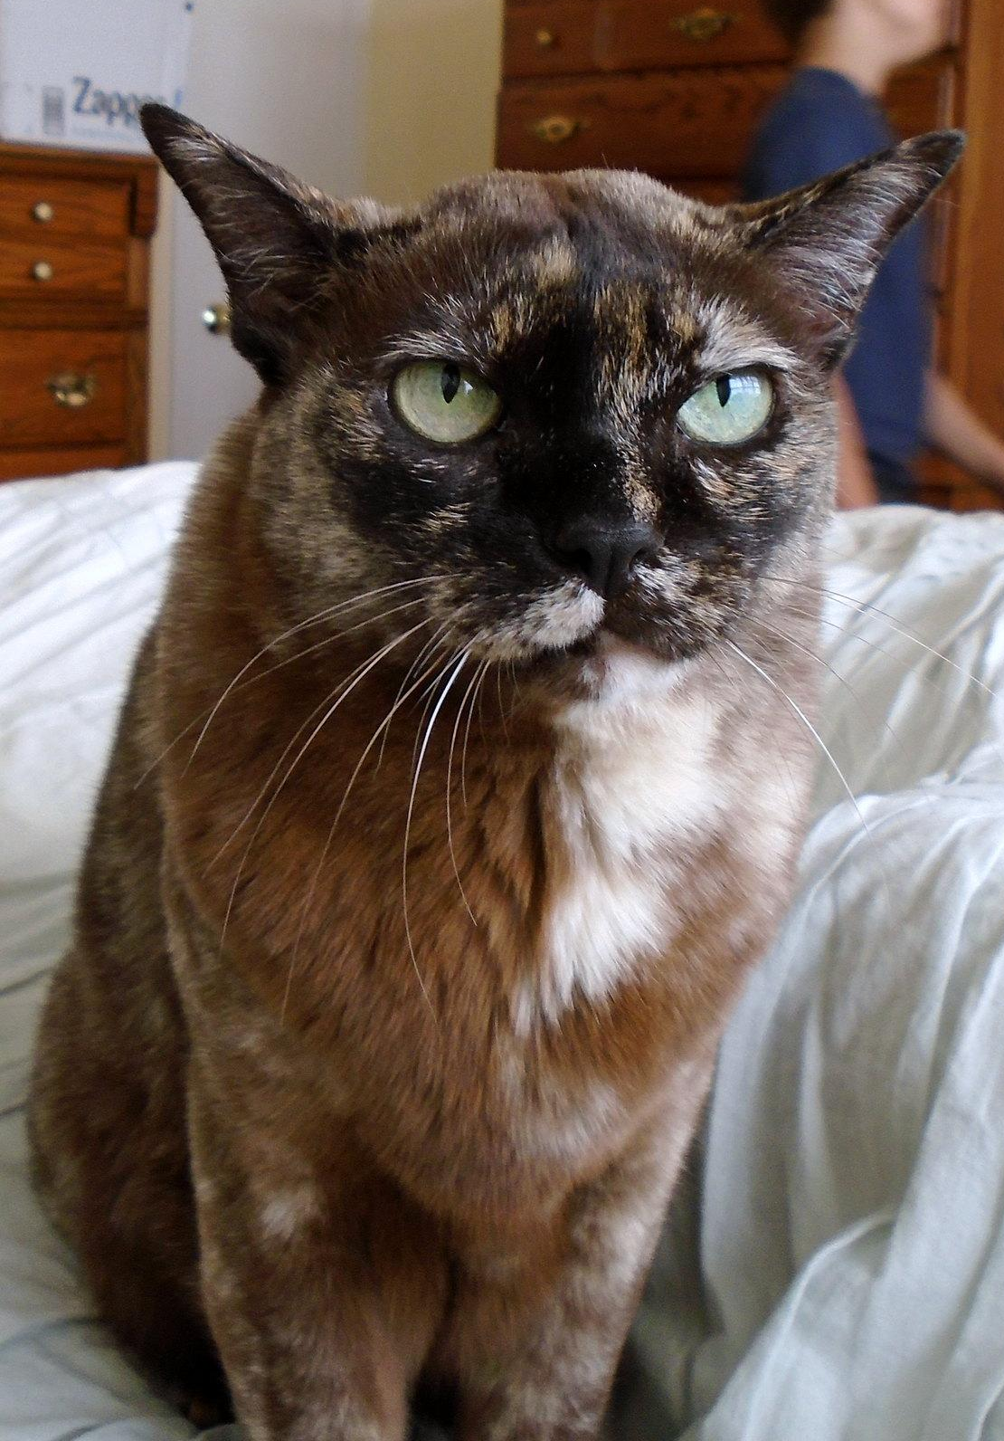
But mostly...
I HATE being bored
¯\_(ツ)_/¯
CC BY Classroom Camera (Cascade Canyon School) https://flic.kr/p/ESKv8X

Slide 5
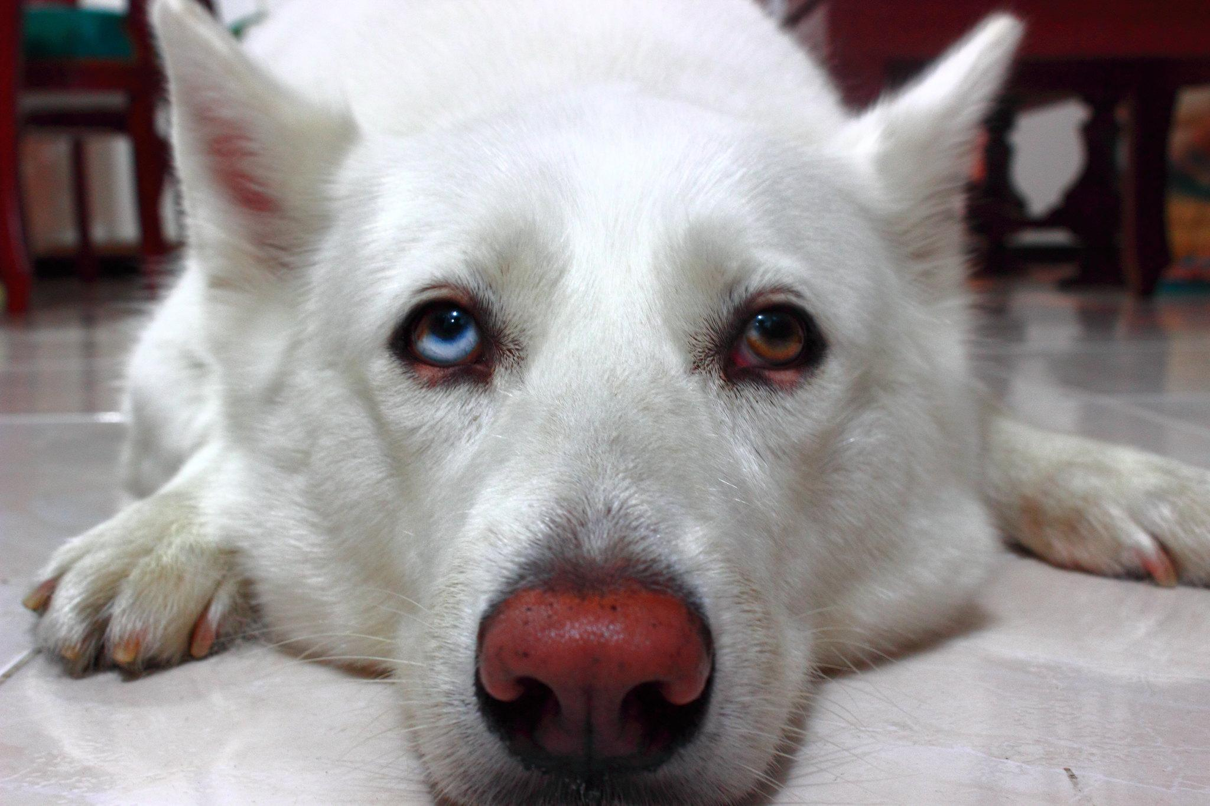
What do you hate about bad meetings?
What is a characteristic of a bad meeting for you?
Type your answer into chat (publicly, or send to me privately) or just shout it out loud
CC BY-SA Camilo Vander Huck https://flic.kr/p/o5BVYm

Slide 6
TL;DL version of this talk
Most of us know what it takes to run an efficient meeting: agenda, moderators, note-takers, follow-up
The hard part is actually doing those things!
Use standard habit-building techniques to gradually add new meeting behaviors for yourself

Slide 7
Basic good meeting habits
Create an agenda and send it out in advance
Assign meeting roles at the beginning of the meeting
Take meeting notes in a shared document
Label action items and review them in the next meeting
End meetings on time

Slide 8
A few standard habit-building techniques
Start small
Identify your motivation
Chain new habits off old ones
Pre-commit to another person
Create small annoying self-imposed penalties
We will do an example and exercise for each of these

Slide 9

Habit-building: Start small
Making several big changes all at once is hard!
Making one tiny change is easier
Once that change becomes habit, it is even easier
New habit seems too hard? Make it EVEN SMALLER
CC BY woodleywonderworks https://flic.kr/p/4LJP43

Slide 10
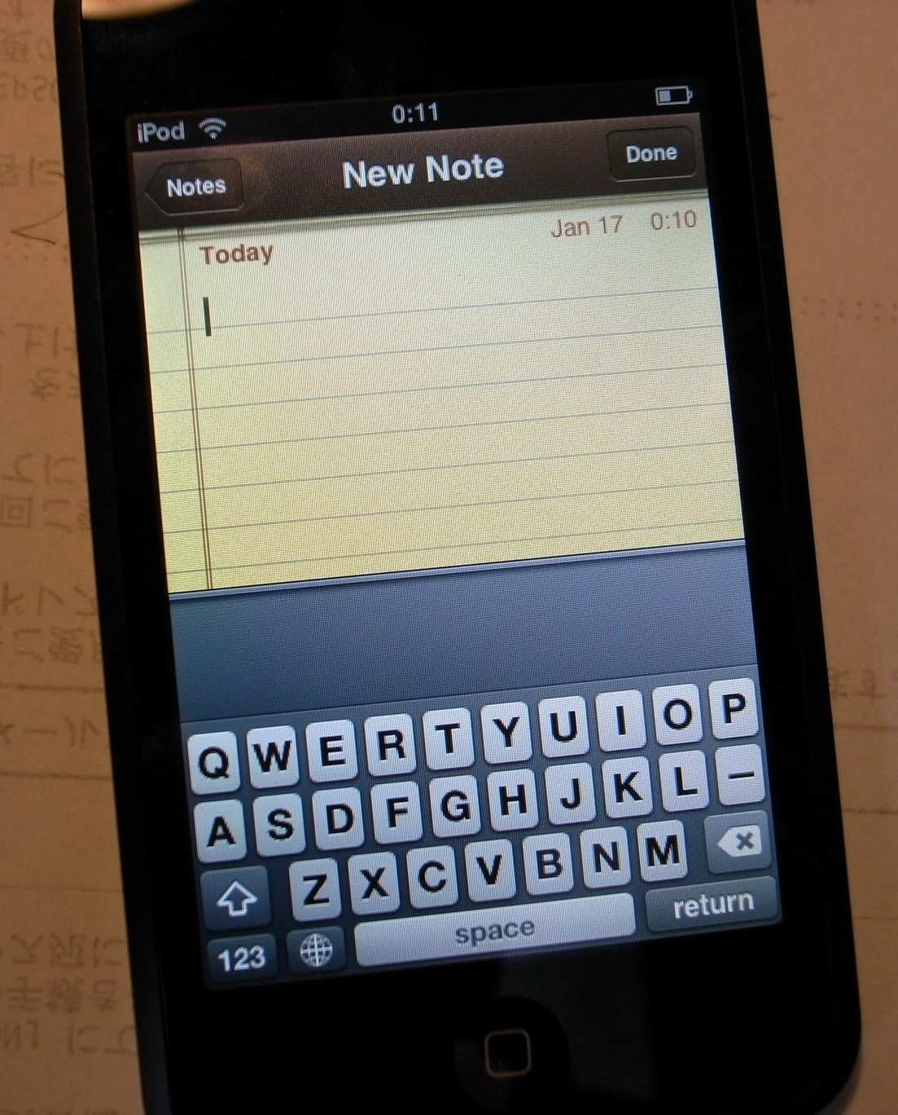
Exercise: Start small
Start a text document - any kind, whatever you like most
Use voice to text if walking around
Write "Meeting habit-building notes" at the top
You're done! You started small and you are now taking notes
CC BY bizmac https://flic.kr/p/4m8W3V

Slide 11
Exercise: Identify your personal motivation
Write in your document how your life and job performance would be better if:
You spent less time in meetings
You were engaged and interested in all your meetings
You were fully prepared for all your meetings
Share in chat or say out loud if you feel like it
Extra credit: write it on a sticky note on your monitor

Slide 12
Exercise: Identify your personal ANTI-motivation
Write the positive things you get out of:
Spending more time in meetings
Going to boring meetings that don't engage you
Not preparing for meetings
Share in chat or say out loud if you feel like it
Extra credit: write it on a sticky note on your monitor

Slide 13
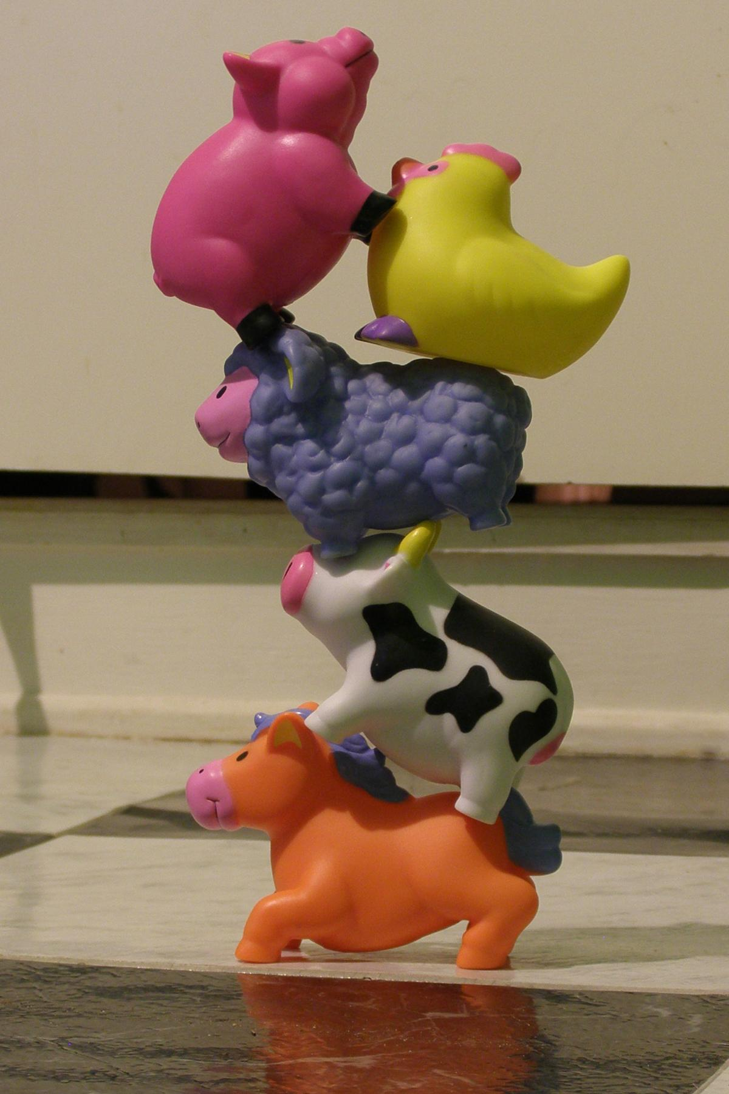
Habit-building: Chain new habits off old ones
You started small, now you have one tiny new habit
Now add a second tiny habit that is connected to the first habit
E.g. if you brush your teeth every night, you can add a new nightly habit by doing it before or after that
CC BY-SA amboo who? https://flic.kr/p/2LPqNY

Slide 14
Chaining habits to get to an agenda
When creating a meeting invite (existing small habit), type "Agenda - please add items" into the invitation description (new small habit chained off first habit)
That counts as "having an agenda"
Once that gets easy, type one item below it, then three items, then move the agenda into a separate doc, add a section for action items, etc.

Slide 15
Exercise: Write an agenda for your next meeting
Open or create the invitation for your next meeting (if you don't own a meeting, make a fake invitation)
Write "Agenda - please add items" in the description field
Save it. You're done! You made an agenda!
Extra credit: When you remember something you want to talk about in the meeting, add it to the invitation

Slide 16
Meeting roles prevent bad meetings
Every meeting should have people filling these roles:
Facilitator - runs meeting
Moderator - gives everyone a chance to speak
Note-taker - takes notes
Timekeeper - tracks time and interrupts if necessary
https://frameshiftconsulting.com/meeting-skills/

Slide 17
Moderated vs. unmoderated meetings
Moderated meetings require people who feel responsible and empowered to keep discussion useful
Unmoderated meetings use the "unmoderated caucus" format with no formal responsibilities
Both styles "work," but one requires planning and work in advance
Why do all the work of meeting roles?

Slide 18
Because "unmoderated caucus" format is terrible
Rule: "The first person to start speaking gets the floor"
This rule discourages "listening" and "thinking" and incentivizes speaking quickly, at length, and without pausing
What does this do to your meetings?
Favors people with a high "caucus score" (calculate yours)
https://chelseatroy.com/2018/03/29/why-do-remote-meetings-suck-so-much/

Slide 19
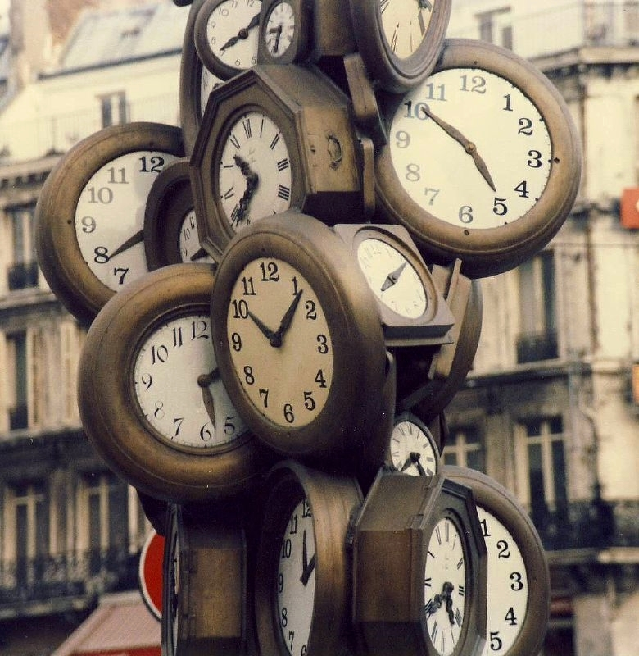
90 second stretch break
Preview of Zoom fatigue tips!
Turn off your camera and move around
Thought to take with you:
Unmoderated meetings discourage "listening" and "thinking" and incentivize speaking quickly, at length, and without pausing
CC BY Nick https://flic.kr/p/5bt6cp

Slide 20
Habit-building: Pre-commit to another person
Many people have strong "But I promised!" energy
If you run a meeting, tell the person in that meeting that you would least like to disappoint that you are committing to a new small meeting habit
Give them permission to remind you, publicly or privately
Ideally, make a two-way pact or competition

Slide 21
Exercise: Pre-commit to one meeting role
Identify a meeting role you want to use in one upcoming meeting (just one, start small)
Decide whether you will assign it, ask it, or do it
Choose a person you will tell about this resolution
Write all this down in your document
Extra credit: Add this to the first line of your agenda

Slide 22
Using meeting roles
Include assignment of meeting roles in your standard meeting agenda template (chaining habits)
One person can take on multiple roles
Note-taker cannot participate fully, so if that is not their official job duty, rotate the note-taker and have a backup note-taker for when primary note-taker speaks
Do not just ask for volunteers!!! Rotate/assign

Slide 23
Habit-building: Creating self-imposed penalties
You decide to do a small negative thing if you fail to follow through on your new habit
Penalties should be more unpleasant than the unpleasantness of starting the new habit
Penalties should be in proportion to your means
Telling other people about your decision helps keep you accountable

Slide 24
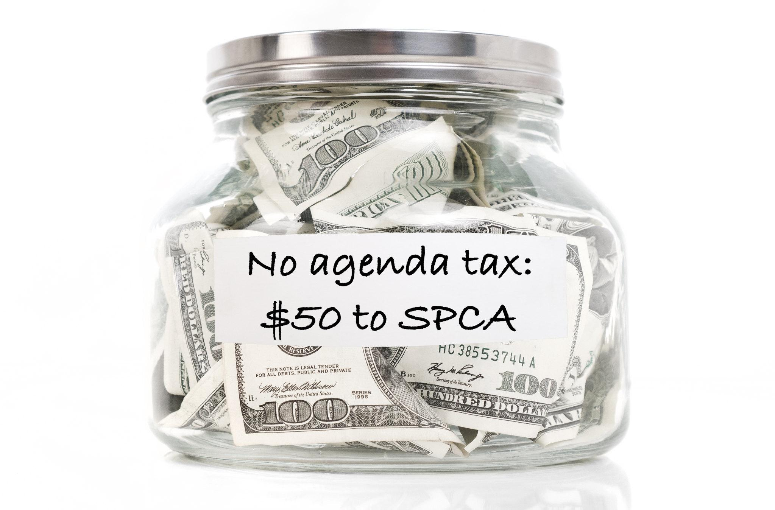
Suggestions for self-imposed penalties
What self-imposed penalties work for you?
CC BY Pictures of Money https://flic.kr/p/s6cDWa

Slide 25
Exercise: Create self-imposed penalties
Write down a small annoying penalty that would motivate you to follow-through on a meeting habit
Write down a meeting habit you could pair it with
Extra credit: Tell the people in your meetings and give permission to remind you of it
Extra extra credit: Make a bet with someone else also trying to learn a meeting habit

Slide 26
Fighting Zoom fatigue
One real solution: fewer, shorter meetings
Edward Tufte meeting advice: "Finish early" not just on time
Add more breaks - people still thinking, more creative
Cameras off, or at least self-view off
Normalize walking/moving around/being outside

Slide 27
Meeting habits to beat Zoom fatigue
Use Google Calendar "Speedy Meetings" feature
Start meetings 10 - 15 minutes AFTER the hour
Set an alarm for 30 minutes, tell everyone to turn off their cameras for 2 - 5 minutes and move around
Have weekly "ended meetings early" competition
Most powerful person says "I will leave in 5 minutes"

Slide 28
Case study: My agenda/notes system
Meeting facilitator schedules prep time on calendar
Note-taker copies standard agenda template for each meeting (meeting roles, action items, etc.)
Repeating meetings: create new agenda at the end of every meeting; everyone adds items until next meeting
All meeting notes are in shared documents in shared folder with standard naming so always available

Slide 29
Case study: Wikimedia unconference
Gave a talk explaining meeting roles and agendas
Created a template agenda available on EtherPad
Printed cards for each room explaining:
meeting roles
short link to agenda template
directions on how to link notes into main document
Result: easily findable notes for dozens of sessions

Slide 30
Summary
Changing meeting habits is hard!
Use standard habit-forming techniques
Start with ONE SMALL habit and use motivation, chaining, pre-commitment, and penalties to adopt it
No, that habit is too big, pick a smaller one
Use any other method that helps you get things done

Slide 31
Q&A
Valerie Aurora
Frame Shift Consulting
http://frameshiftconsulting.com/ally-skills-workshop/

